Slide 1

Recipe FOR Success in IT
Victor Grazi
VP – Enterprise Infrastructure Engineering
Nomura Securities
Notes:
We can talk about how to get there from here. It’s not fast, there’s politics, but you want to position yourself so that in five years you can look back and say I made some good progress. And in ten years even more.

Slide 2
About me – Victor Grazi
VP Enterprise Infrastructure Engineering at Nomura
Served on the Java Community Process Executive Committee
Outstanding Spec Lead for JSR 354 – Java Money & Currency
Served as Java Lead Editor at InfoQ
Java Champion since 2014
Pluralsight course author – Regular Expressions in Java
Frequent speaker at technical conferences
Notes:
It seems like a respectable resume, but how did I get this. It doesn’t happen overnight, but there is a formula and that’s what I’d like to discuss tonights

Slide 3

I. Landing (and keeping) a CAREER KIND of Job

Slide 4

Plan to intern before you graduate
Financial and Technology pay the highest
Don’t leave gaps in your resume.
Have a professional review your resume. Recruiters will do this for free.
Don't stagnate in your job.
Speaking about moving on, what is the right strategy there?
Job change easier to get more money…
but you don't want to appear mercurial.
“Why are you leaving your current job?”
Notes:
Your hardest job is your first one. Interning at a major corporation gets that most important first job behind you.
tech and financial are well known for rewarding staff with high bonuses, especially hedge funds. So if you make yourself valuable you never know!
Never leave gaps in your resume. If you are out of work for a while, position it as consulting.
have a professional review your resume. Recruiters will do this for free. You are their inventory, they will treat you as such, as long as they think they can make money off you
Don't stagnate in your job. Your job will have routines that you do every day and you might get very good at that, but then 3 years later you move on and discover you're a dinosaur
Speaking about moving on, what is the right strategy there? You are likely to make more money from a change then you will from a raise. But you don't want to appear mercurial. One of the biggest red flags I see on resumes is someone who moved every year or two. 4 years in the same place means you were valued for 4 years. It's hard to fool someone for 4 years, so that injects a lot of credibility
First question an interviewer asks is why are you leaving. Never never say I want more money, because them they'll think you'll leave them for more money

Slide 5
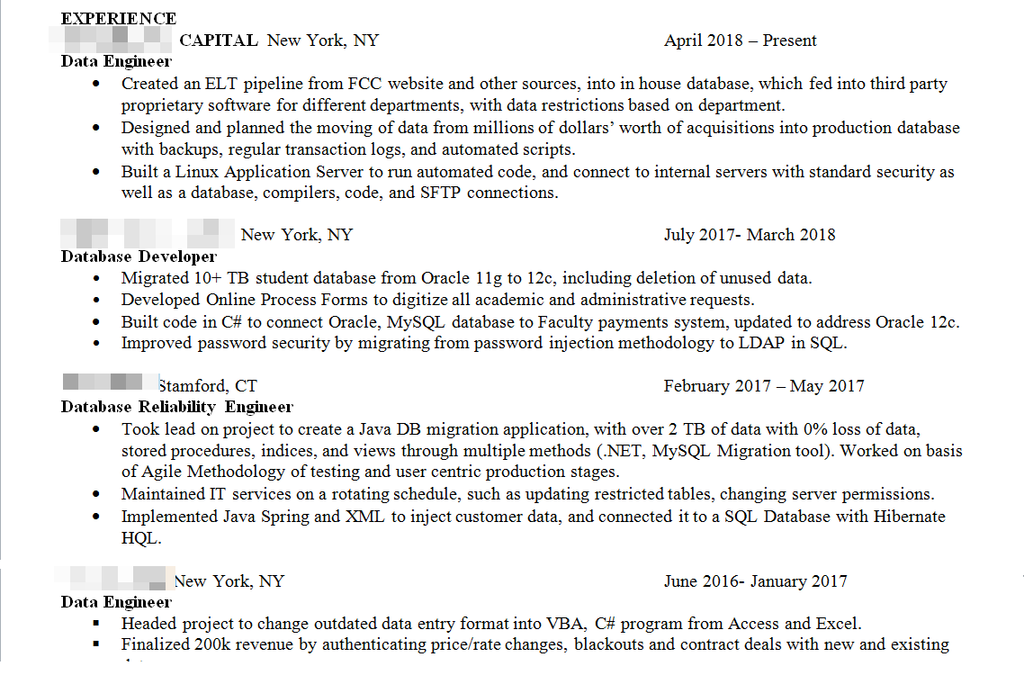

Slide 6


DEI/Affirmative action programs for women
Can’t ask your salary history
Can’t ask about plans for marriage or children
Can’t discriminate against religious, gender, or handicap
Break the glass ceiling
Notes:
The glass ceiling is shattering
there is currently a lot of affirmative action for women, you have a big advantage
And now by law in NYS, it is illegal to ask you how much you make. They can only ask how much are you looking for.
they can't ask if you’re planning to marry or having kids. They can’t discriminate against you if you need to leave early on Friday. I explained to my team, you can’t reach me on Saturday or holidays. If it’s really an important emergency, I still can’t be reached. Leave me a message and I will get back to you after sunset.

Slide 7
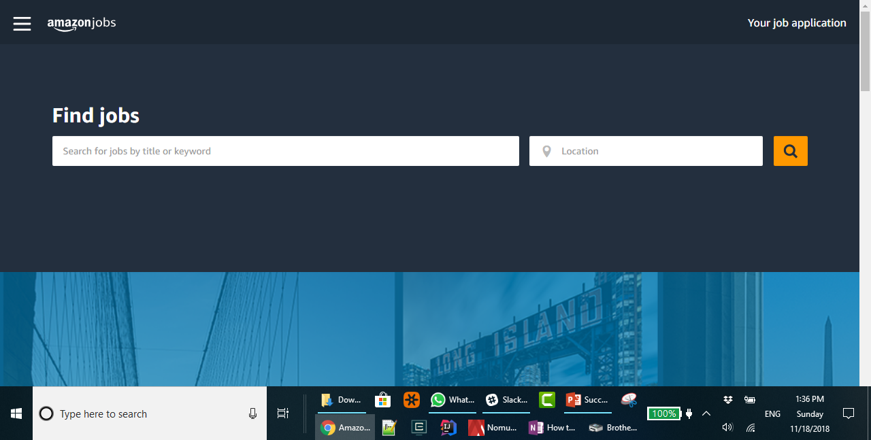
Java Developer
New York City
Corporate Job boards
Recruiters
Your network
Notes:
Make sure recruiters understand that they may not share your resume without your permission
I do not like recruiter job boards, however banks and technology firms all post their job openings
Market is hot hot hot right now.
Trump has been very tough on immigration. It’s impossible to get H1 visas anymore. That makes it tough for hiring managers, but if you are a citizen or have a green card, it makes it means more opportunity for you.
All of this means that there has never been a better time for you in technology or in any field

Slide 8

II. developing Your Expertise

Slide 9

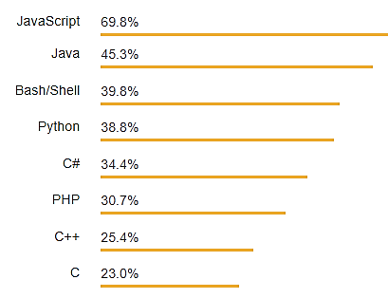
Technologies and Languages
Technologies
Cloud
Machine Learning
Big Data
Reactive Programming
Languages
JavaScript
Java
Python
Golang
https://insights.stackoverflow.com/survey/2018/
Notes:
You think nowadays, there are so many experts it's to hard to be an expert.
Not true... There are so many new technologies it's easy to develop an expertise in one that interests you
Become good, answer questions on Stack Overflow./com
big Data is not big, it's huge
Also, machine learning. Anybody can learn enough Python or Java to be dangerous, but machine learning really requires separates the men from the boys. It pays great but you need to know how to program and you need multivariate calculus and linear algebra.
Stay in good technical Shape!!

Slide 10

It’s not that I’m So Smart… It’s just that I stay with the problem longer
Albert Einstein
Notes:
When you study, really infuse yourself until you have a visceral understanding
There are plenty of quality on-line courses that are free or very cheap
Pluralsight, Udemy, Coursera, YouTube, but in any case. experiment!

Slide 11

III. developing Your Network

Slide 12

Network
Network
Network
Plus a heaping portion of passion and enthusiasm!!
If you're shy, join the club. Find someone successful, develop a relationship, and ask them to be your mentor!
The Most Important Ingredients For Success in IT
Notes:
If you're shy, find someone successful and ask them to mentor you! Offer to help them and they will help you
Become a go to person.
Ask not what your company can do for you, ask what you can do for your company!

Slide 13

A GOOD HOCKEY PLAYER PLAYS WHERE THE PUCK IS; A GREAT HOCKEY PLAYER PLAYS WHERE THE PUCK IS GOING.
Wayne Gretsky – Considered “The Greatest Hockey Player Ever”
Notes:
We are not hockey players, but we do need to keep our eye on where the puck is heading. Which are the coming technologies, what languages are going to be sought after?

Slide 14

Social Networking
LinkedIn
GitHub
Stack Overflow
Apache Software Foundation
Java Community Process /Open JDK
Source Forge
Notes:
Keep your LinkedIn profile up to date an compelling
Contribute to open source. Keep your code in GitHub. Experiment, and keep it as an archive This
Then any project you are working on becomes open source
And the code becomes your resume.
Keep your name clean. It’s your most valuable asset and it’s a very small world

Slide 15

Editorial Content
InfoQ
DZone
CodeRanch
Java Code Geeks
Reddit
Notes:
Contribute to these things. Keep your code in GitHub. Experiment, and keep it as an archive This
Then any project you are working on becomes open source
And the code becomes your resume.

Slide 16

IV. Office Etiquette

Slide 17

Be respectful of different cultures.
They are just people after all,
No different from you and me.
Don't indulge in office gossip.
Notes:
You will be thrown with all kinds of cultures. All people are just like you and me.
indians dominate the IT field.
One of our mentors this summer had a manager with an avoda zara in prominent display. I once asked an indian what his screen saver was… "that is god!"
There are many Moslems in the industry. Discover them, believe it or not, they are some of the most trustworthy people you will ever work with. Do kiddush hashem, just be friendly, courteous and helpful, and you might find they will treat you in kind.

Slide 18

V. In Conclusion
Notes:
Cheryl Sandburg is the CEO of facebook. In her best selling book Lean in, she confesses that she put off having children and put her career first. Her husband had a heart attack and died, and now she's raising young kids alone
So after all is said and done, you're a woman, you're a person, you're a Jew. Never lose sight of your priorities: your family, your community, and your religion. The workplace is a perfect opportunity to do Kiddush Hashem, even as you grow

Slide 19

Questions?

